Slide 1
Installing docker on Windows 10 Home
Anshu Pandey

Slide 2
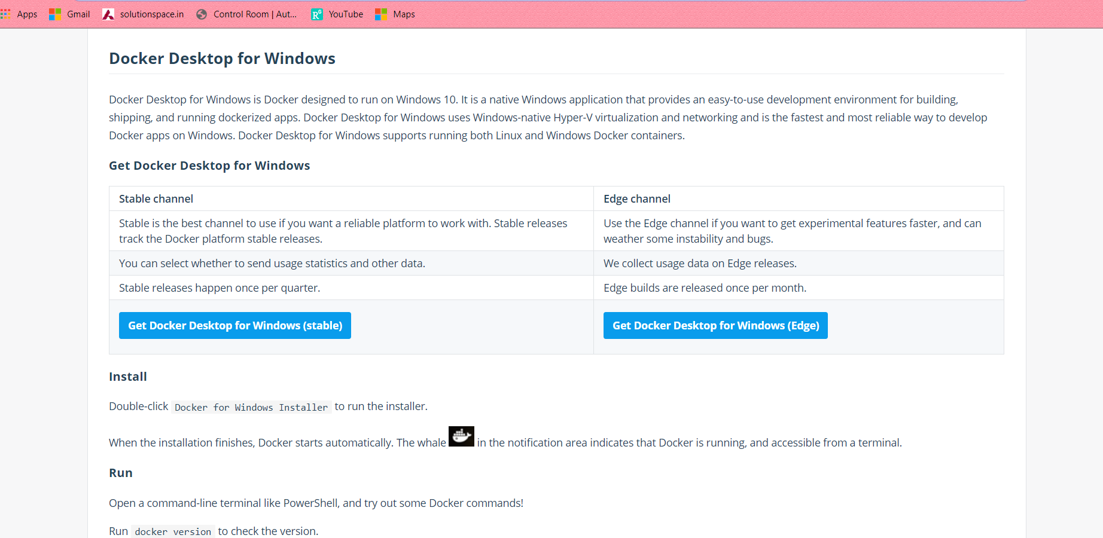
1. Download docker
Download stable version of docker from – https://hub.docker.com/editions/community/docker-ce-desktop-windows/

Slide 3
2. Install hyper-v
1. Create a file called InstallHyperV.bat
2. Add following code to the file –
3. Run InstallHyperV.bat in administrator mode.
This may take few minutes. Say NO to restart at the end
pushd "%~dp0"
dir /b %SystemRoot%\servicing\Packages\*Hyper-V*.mum >hyper-v.txt
for /f %%i in ('findstr /i . hyper-v.txt 2^>nul') do dism /online /norestart /add-package:"%SystemRoot%\servicing\Packages\%%i"
del hyper-v.txt
dism /online /enable-feature /featurename:Microsoft-Hyper-V -All /LimitAccess /ALL
pause

Slide 4
3. Install containers.bat
1. Create a file called InstallContainers.bat
2. Add following code to the file –
3. Run InstallContainers.bat in administrator mode.
This may take few minutes. Say yes to restart at the end or manually restart.
pushd "%~dp0"
dir /b %SystemRoot%\servicing\Packages\*containers*.mum >containers.txt
for /f %%i in ('findstr /i . containers.txt 2^>nul') do dism /online /norestart /add-package:"%SystemRoot%\servicing\Packages\%%i"
del containers.txt
dism /online /enable-feature /featurename:Containers -All /LimitAccess /ALL
pause

Slide 5
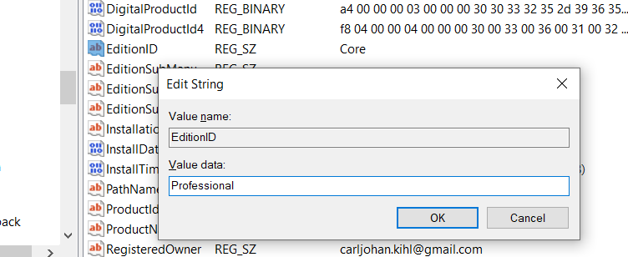
4. Edit Windows Version in Registry
Press Windows + R and write regedit
2. In the Registry Editor, go to \HKEY_LOCAL_MACHINE\SOFTWARE\Microsoft\Windows NT\CurrentVersion
3. Right-click on EditionID and Click Modify
4. Change Value Data to Professional
5. Click ok

Slide 6
5. Install Docker
⚠️ If you restart your computer the EditionID will be reset and you have to set it again.
So install docker without restart, once install you will not need to change anything.

